Slide 1
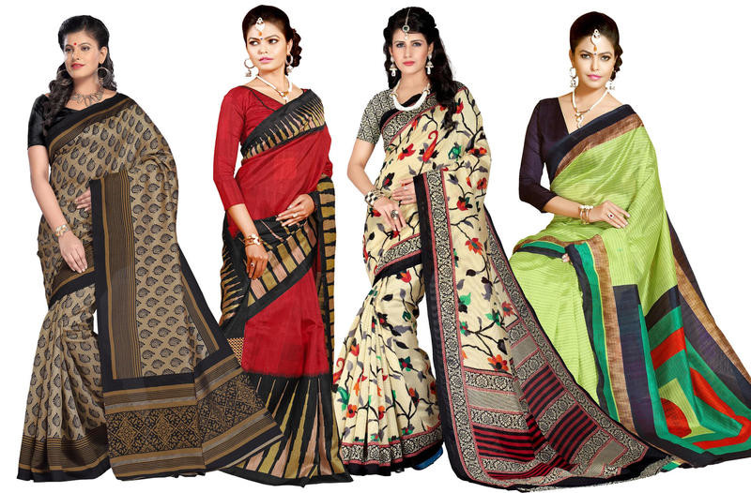
Wholesale Sarees

Slide 2
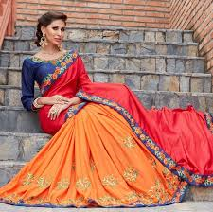
Saree
Saree is one of India’s oldest outfit present till the current date and becoming trending day by day. Always remains high on demand.
The good part is that it can be draped in 100 different styles so is always in high demand.
Retailers can get the best Wholesale Sarees for business on very amazing lower rates from Wholesalebox.

Slide 3
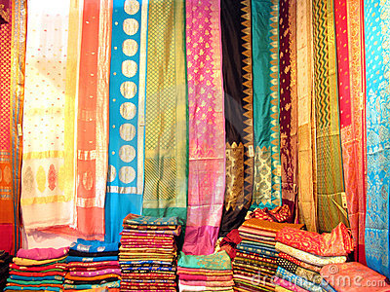
Types of Sarees available
Art Silk.
Georgette.
Cotton Silk.
Chiffon.
Silk.
Chanderi.
Crepe.

Slide 4
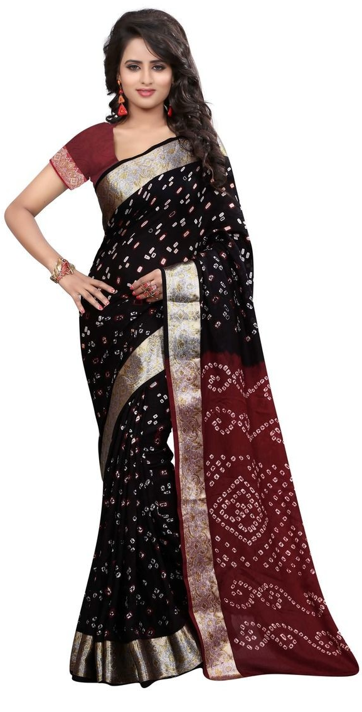
Art Silk Saree
Art silk means Artificial Silk, It is highly on demand in the market due to its unique designs.
Different work type of Art Silk Saree includes Banarsi, Bandhani, Printed, Patola, Woven, Embroidery and Weave.
A good option to buy Wholesale Art Silk Saree at the very high margin for Retailers and so many options to choose from on Wholesalebox.in

Slide 5
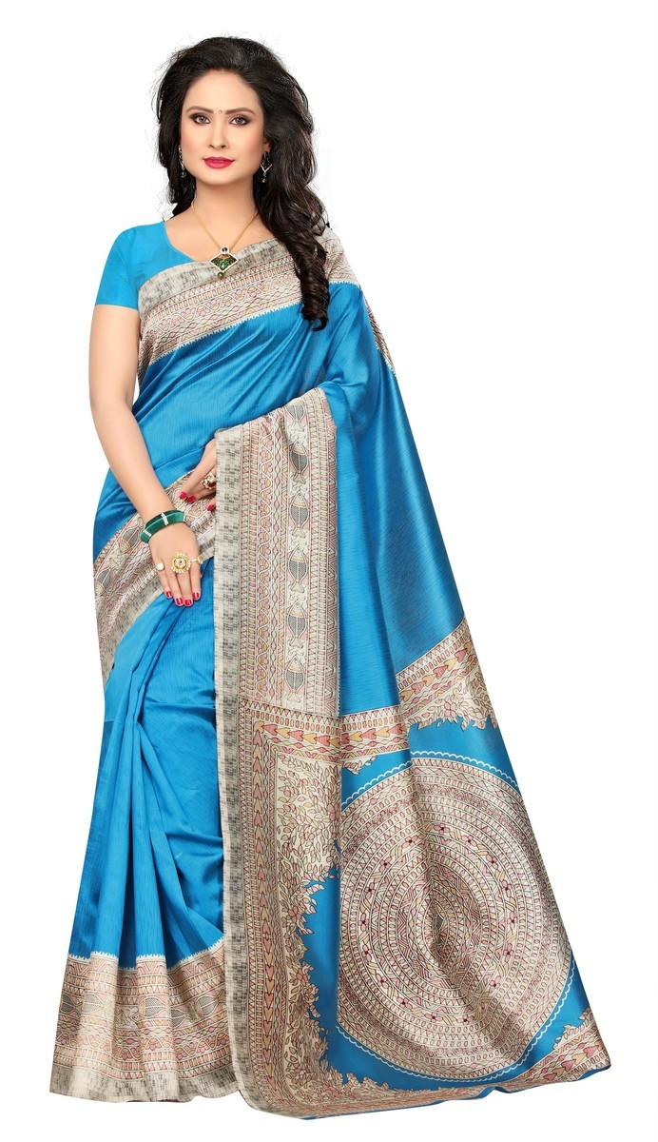
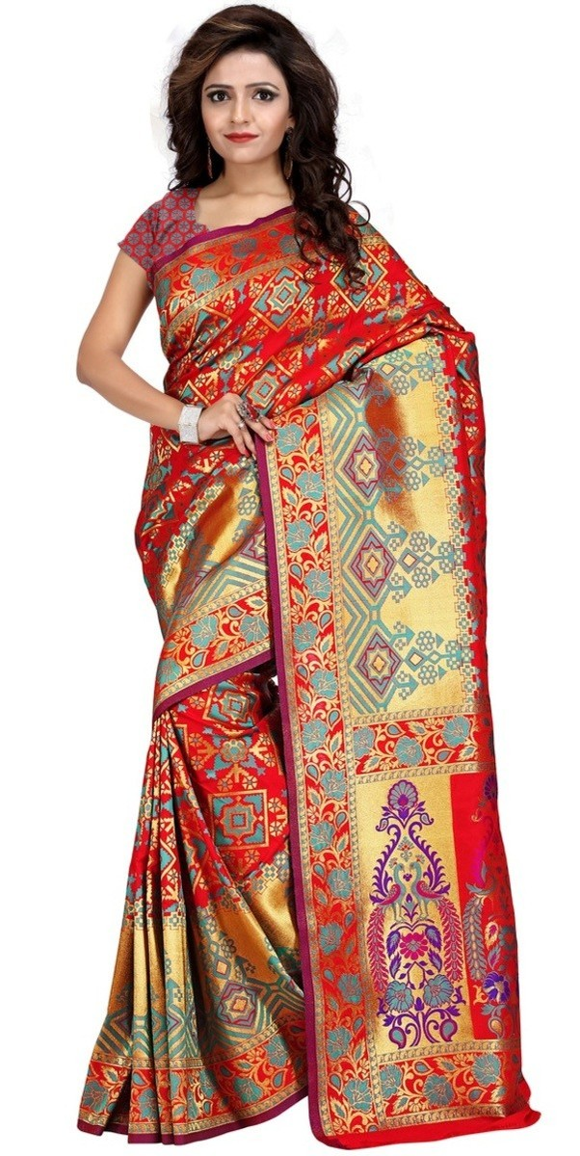
Art Silk Printed Saree
Art Silk Patola Saree

Slide 6
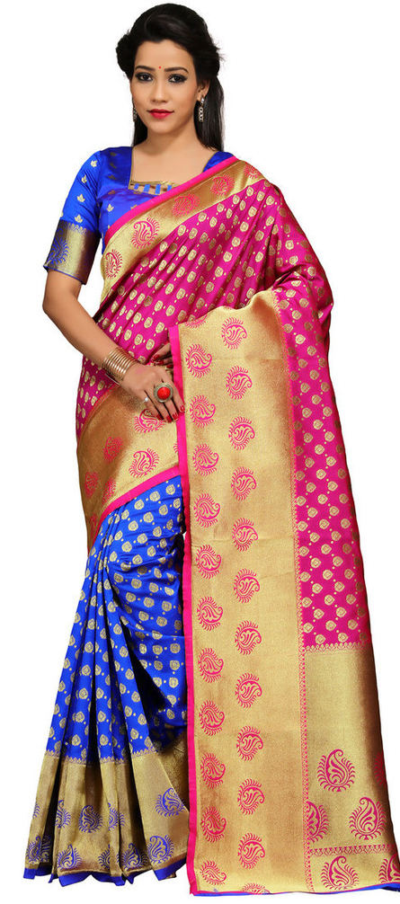
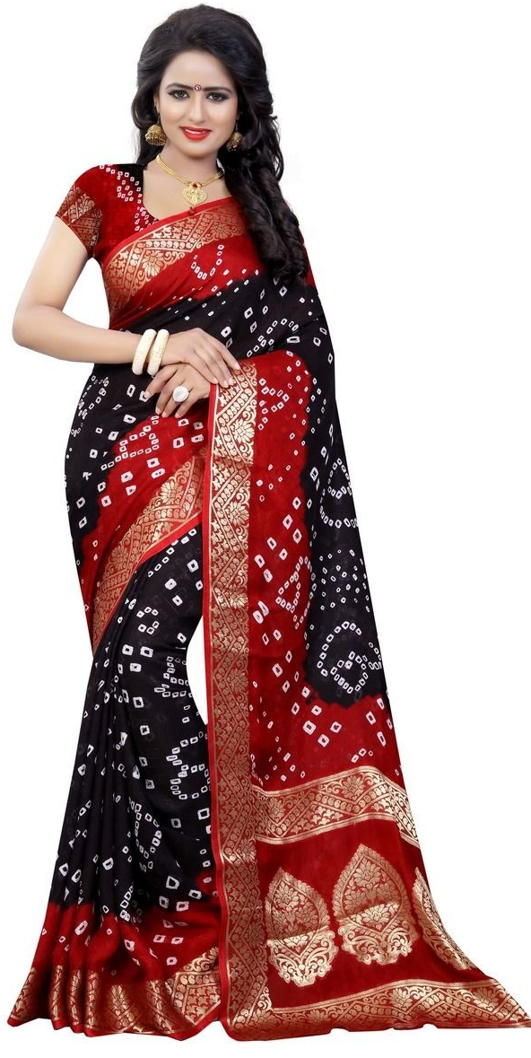
Work Types of Art Silk Sarees
Art Silk Banarsi Saree
Art Silk Bandhani Saree

Slide 7
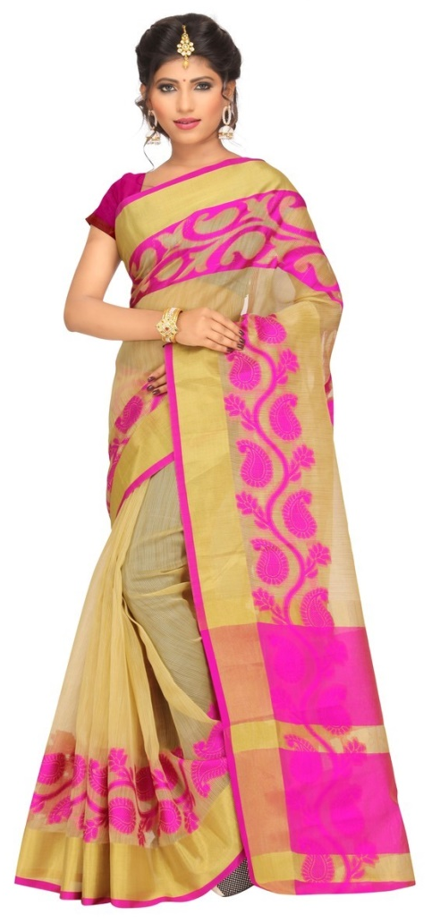
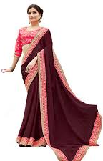
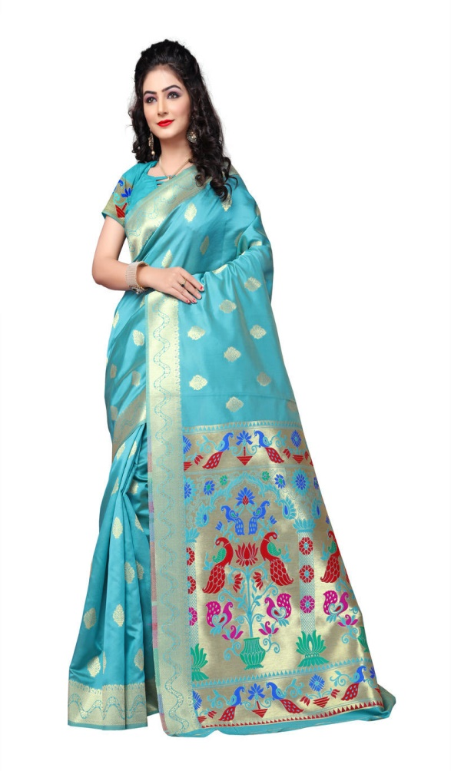
Art Silk Woven Saree
Art Silk Embroidery Saree
Art Silk Designer Silk Saree

Slide 8
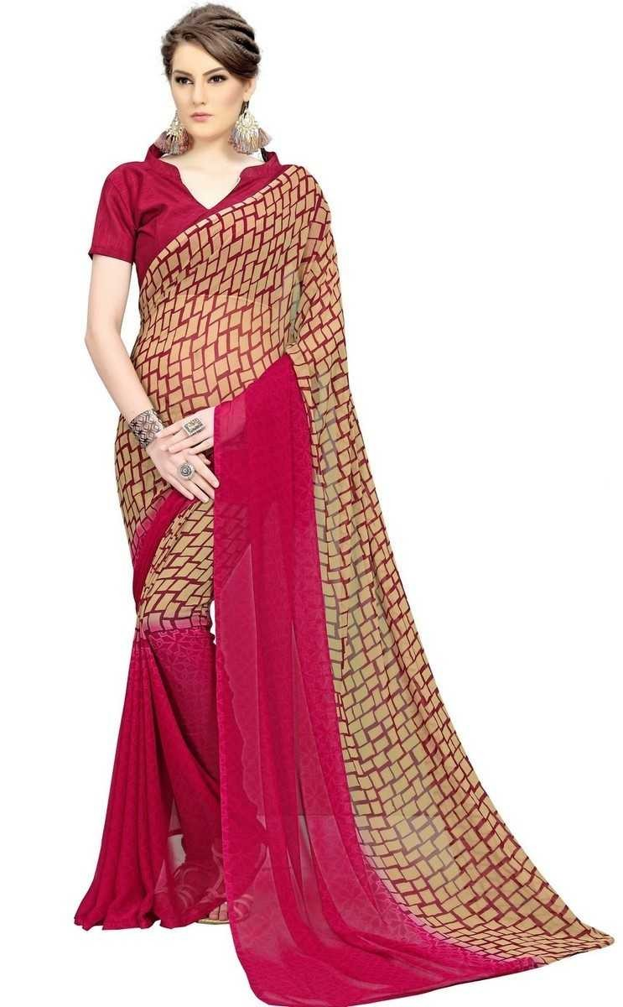
Georgette Saree
At the time of occasions, Georgette Saree is a perfect choice, so Retailers need to improve their collection by adding some Georgette Sarees to it.
Trending types of Georgette Sarees available on our site are Printed, Embroidery, Border Work, Mirror Work, Cut Work, Stone Work.
Retailers can get their Product on High Margin comparatively to the Market available at our website.

Slide 9
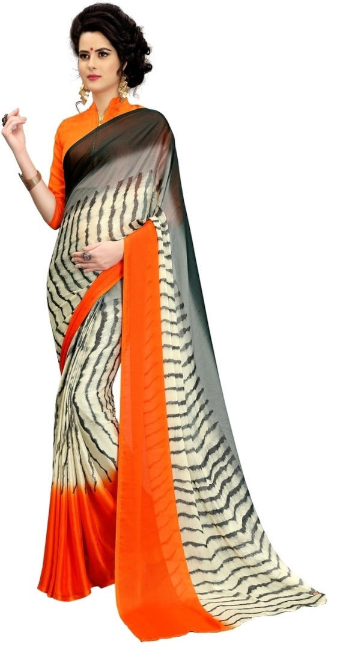
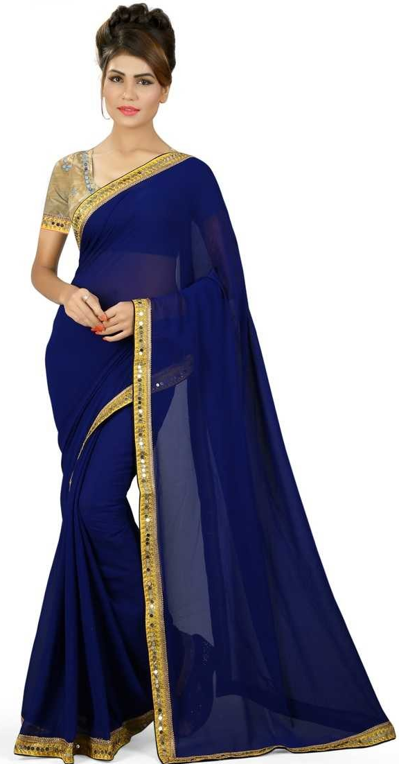
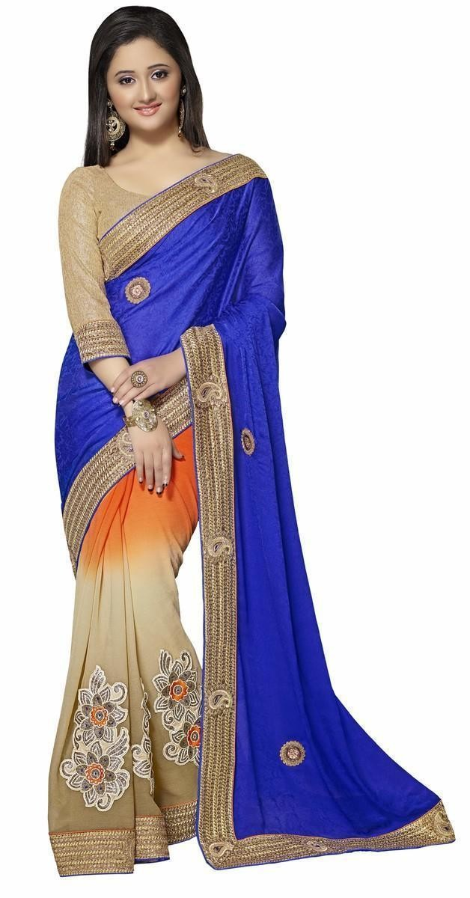
Work Types of Georgette Saree
Georgette Printed Saree
Georgette Border Work Plain Saree
Georgette Embroidered Saree

Slide 10
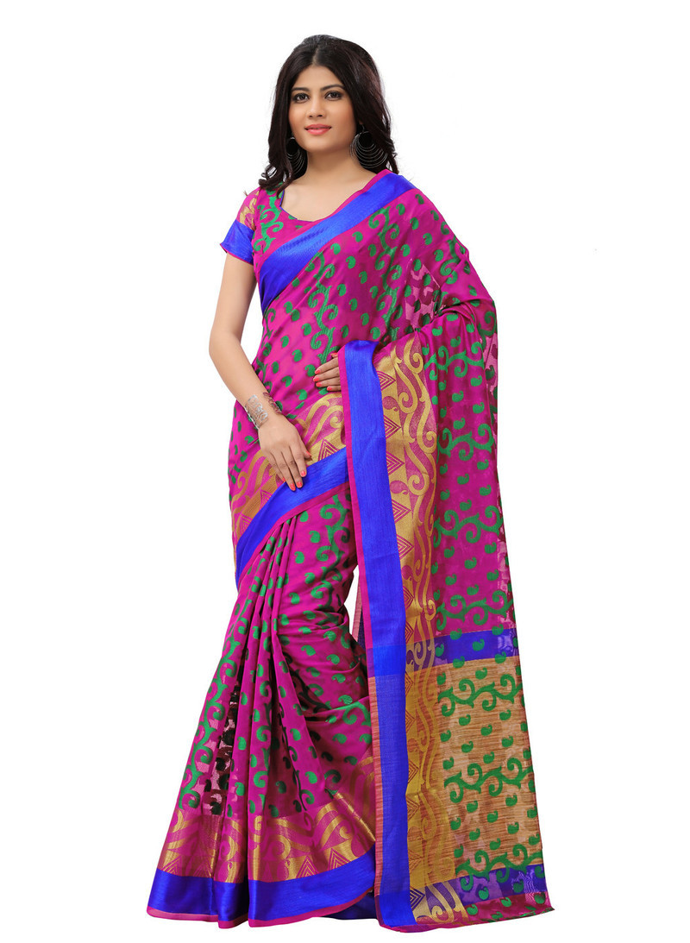
Cotton Silk Saree
We always offer the product range in the finest quality possible. Get some of the trending Wholesale Cotton Silk Saree.
Style available in Cotton Silk Saree on our site are Zari Border, Banarsi, Printed, Woven, Weave, Abstract Printed, Bandhani.
We are having a top brand exclusive collection of Wholesale Cotton Silk Saree.

Slide 11
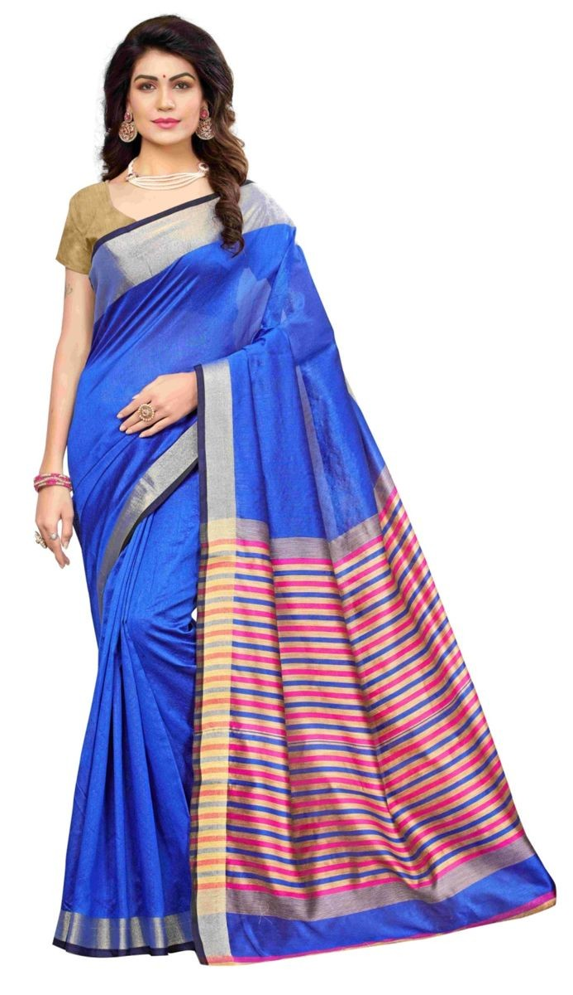
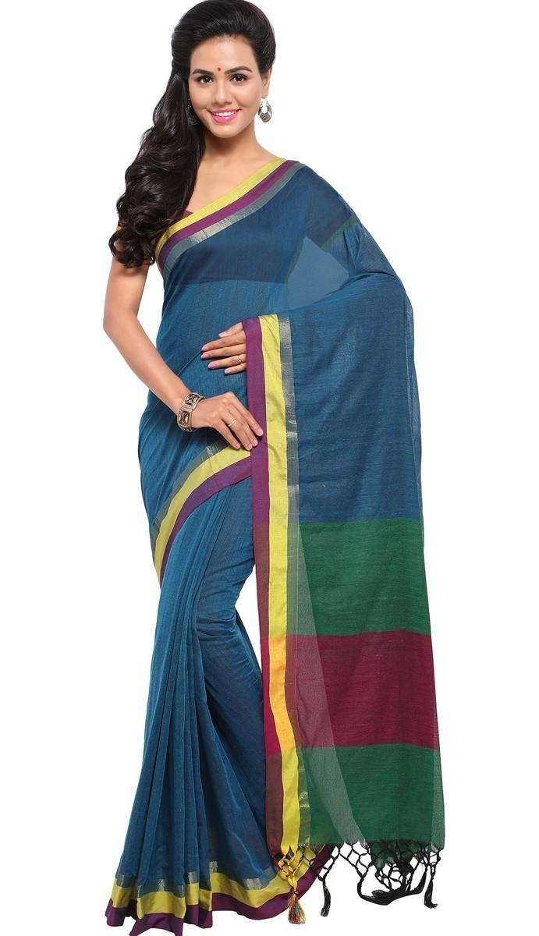
Work Types of Cotton Silk Saree
Cotton Silk Zari Border Saree
Cotton Silk Banarsi Saree

Slide 12
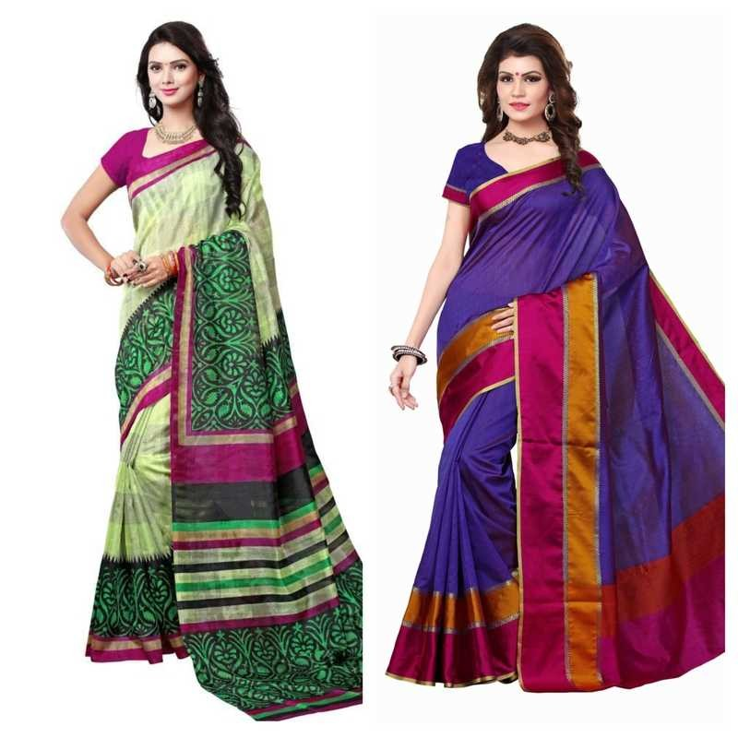
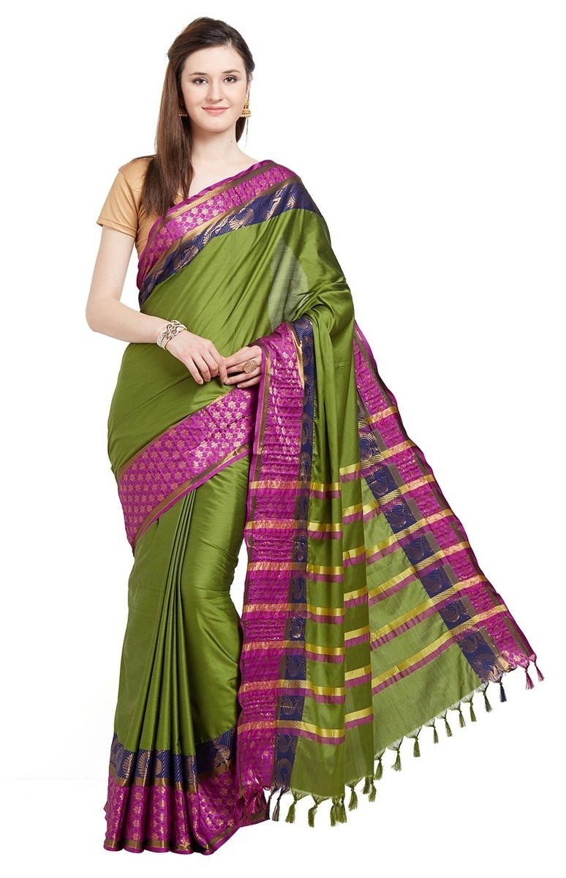
Cotton Silk Printed Saree
Cotton Silk Woven Saree

Slide 13
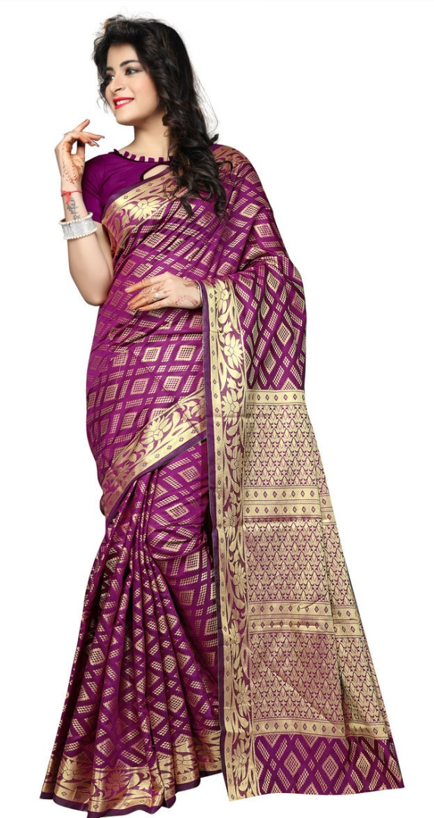
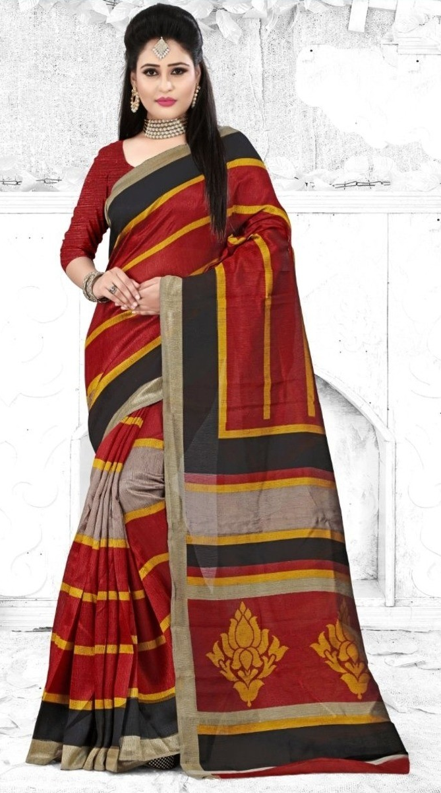
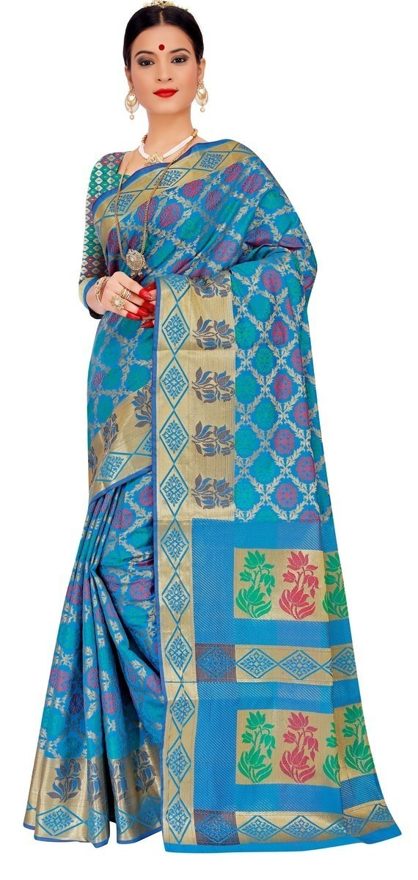
Cotton Silk Designer Weaving Saree
Cotton Silk Abstract Printed Saree
Cotton Silk Bandhani Saree

Slide 14
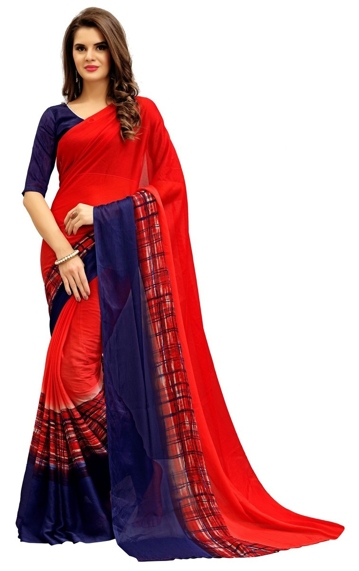
Chiffon Saree
Chiffon Saree Wholesale are popular in various regions in India. We have some good trending Designer pieces.
Elegant Jewelry and Matching options are Also available on our site.
It comes in different work types which are Border Work, Printed, Embroidery, Stone Work, Hand Embroidery, Woven.

Slide 15
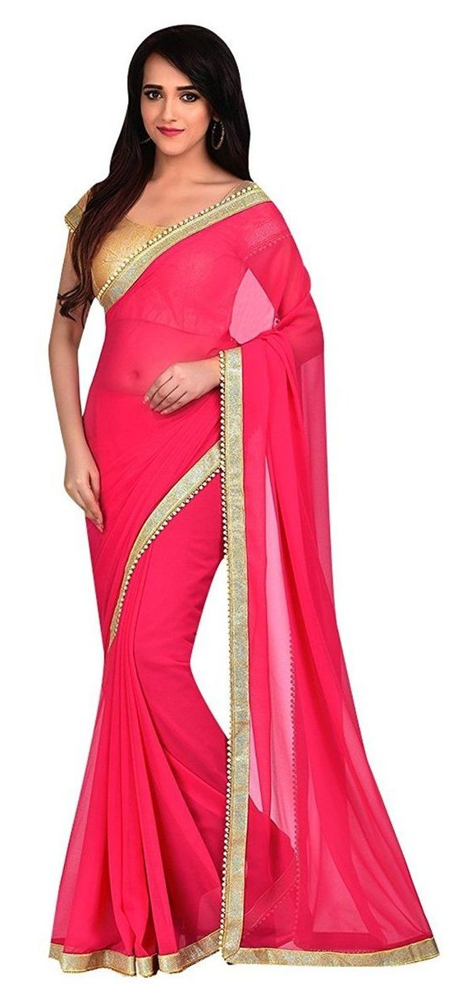
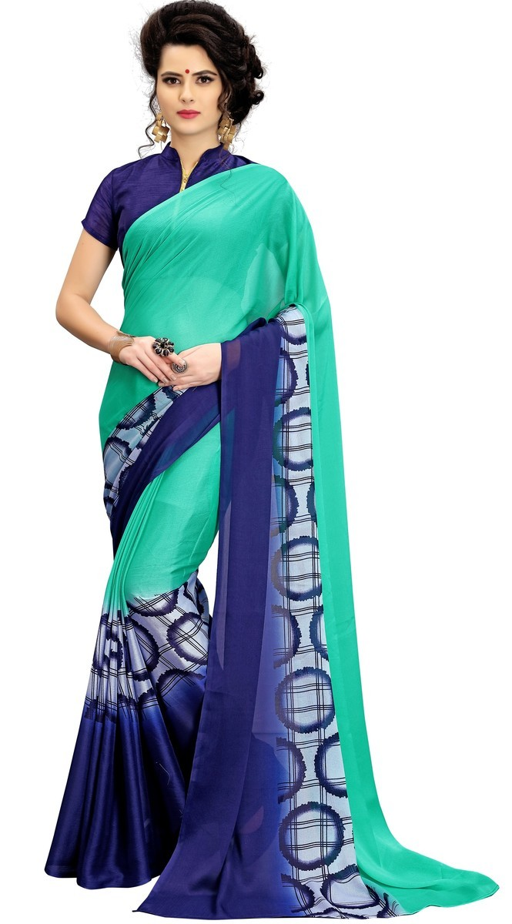
Work Types of Chiffon Saree
Chiffon Border Work Saree
Chiffon Work Saree

Slide 16
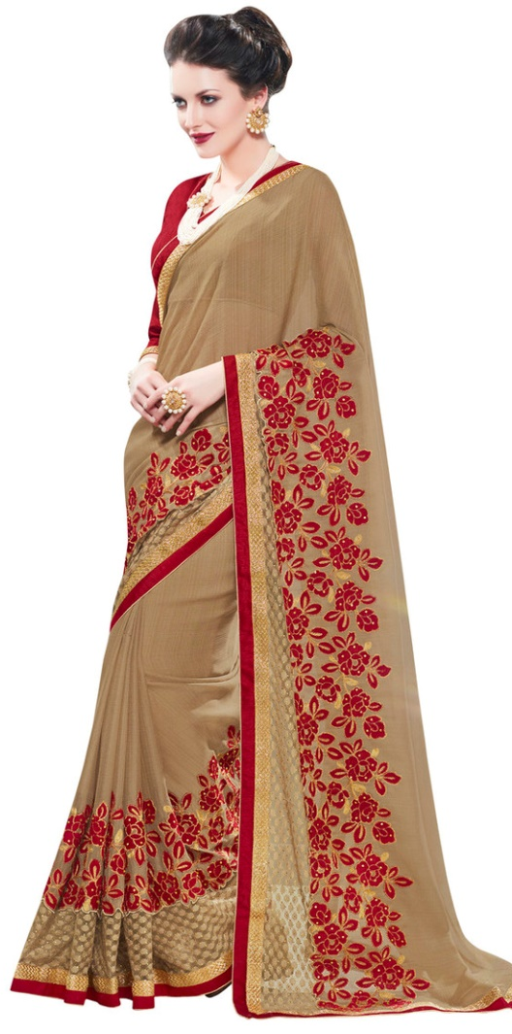
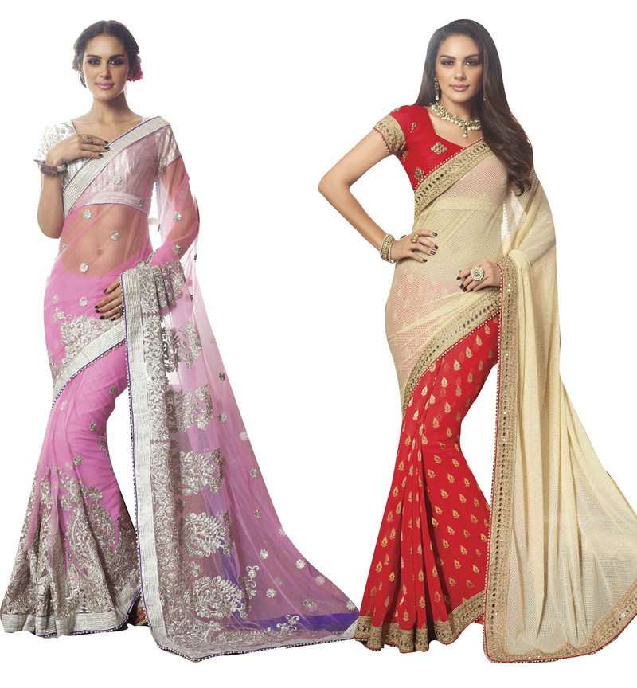
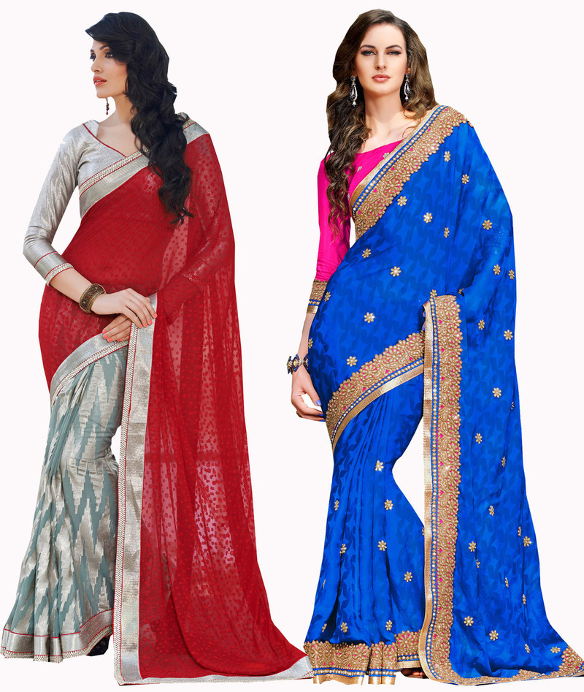
Chiffon Embroidery Saree
Chiffon Stone Work Saree
Chiffon Hand Embroidery Saree

Slide 17
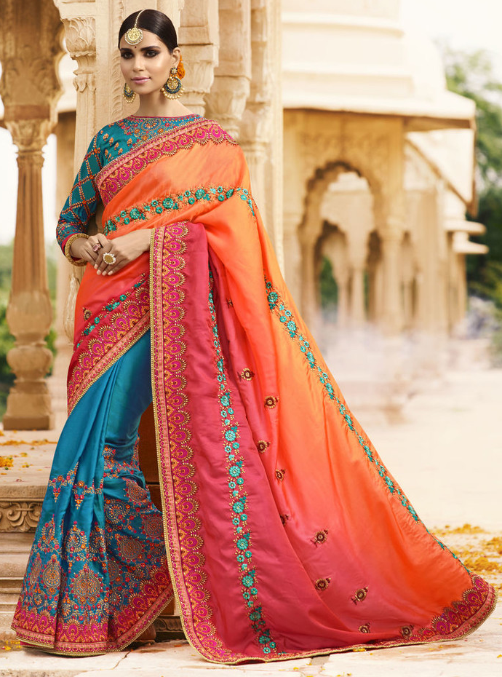
Silk Saree
Silk Saree is known as the Indian Fashion Statement. We have some of the selected Designer Pieces you can Choose from.
Work types in Silk Saree are Embroidery, Border Work, Banarsi, Zari Border, Stone Work, Printed, Weave.
Get the excellent quality Wholesale Silk Saree from our store online.

Slide 18
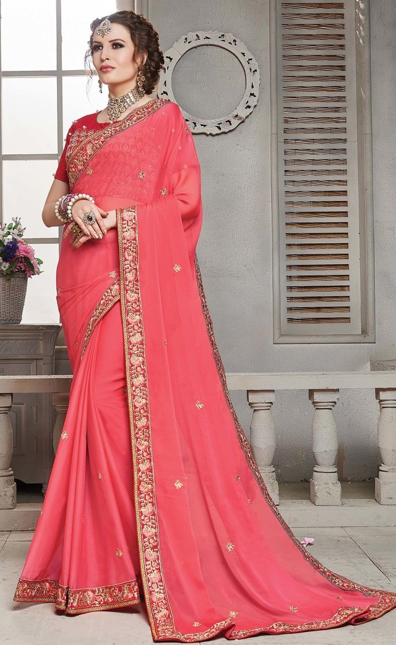
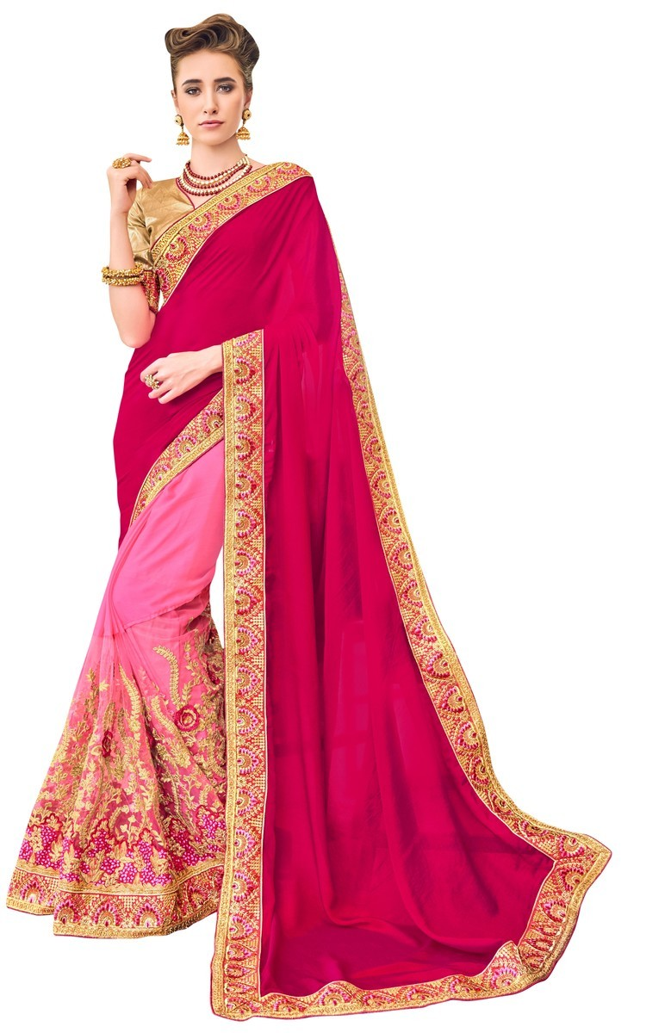
Work Types of Silk Saree
Silk Embroidery Saree
Silk Border Work Saree

Slide 19
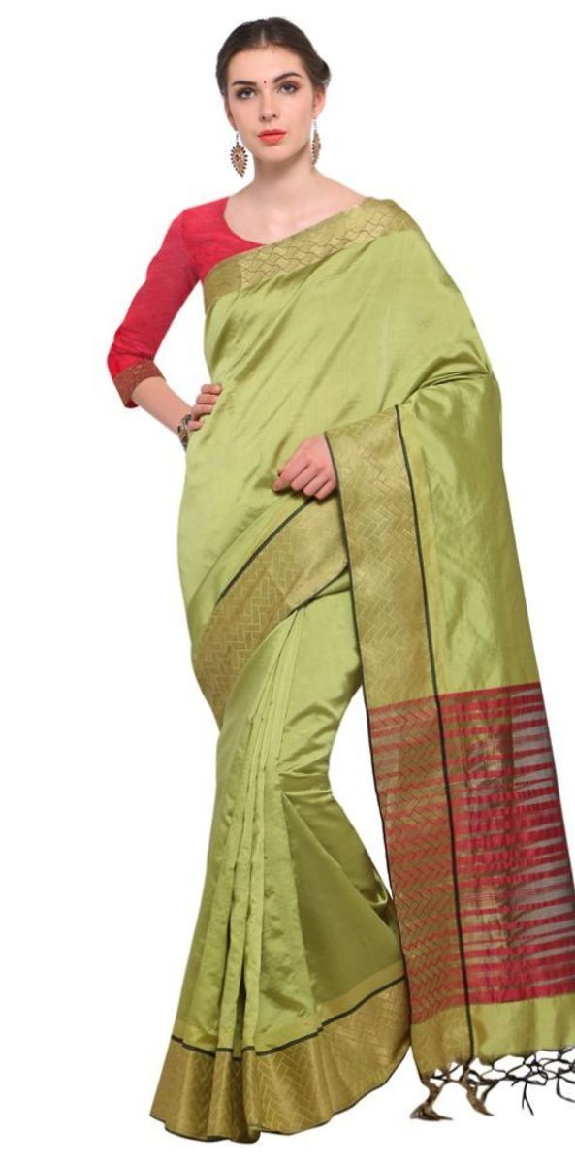
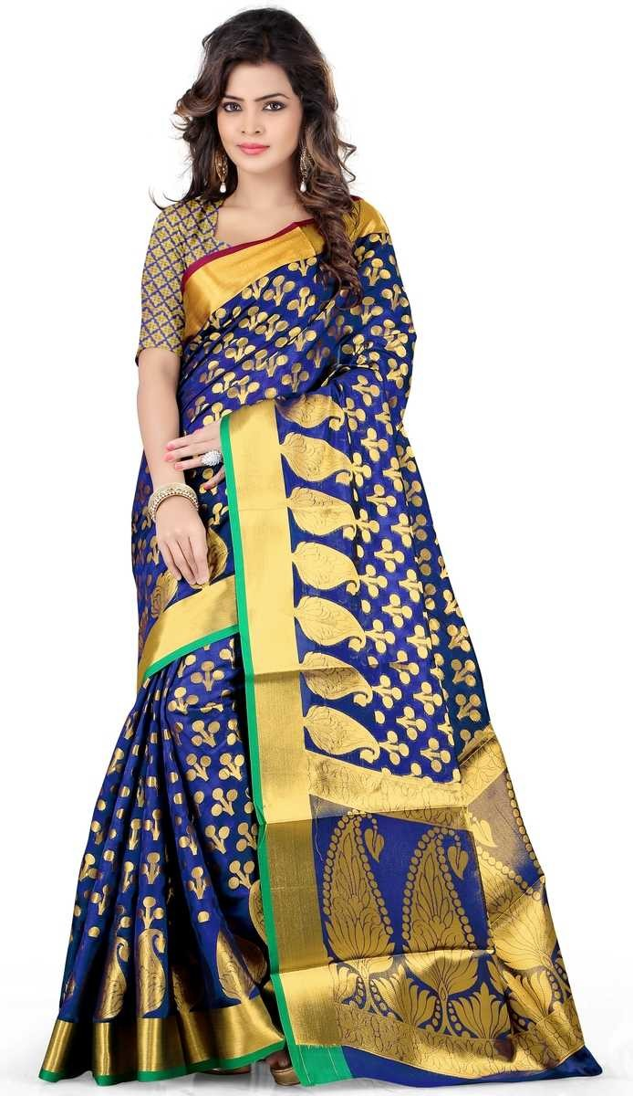
Silk Banarsi Saree
Silk Zari Border Saree

Slide 20
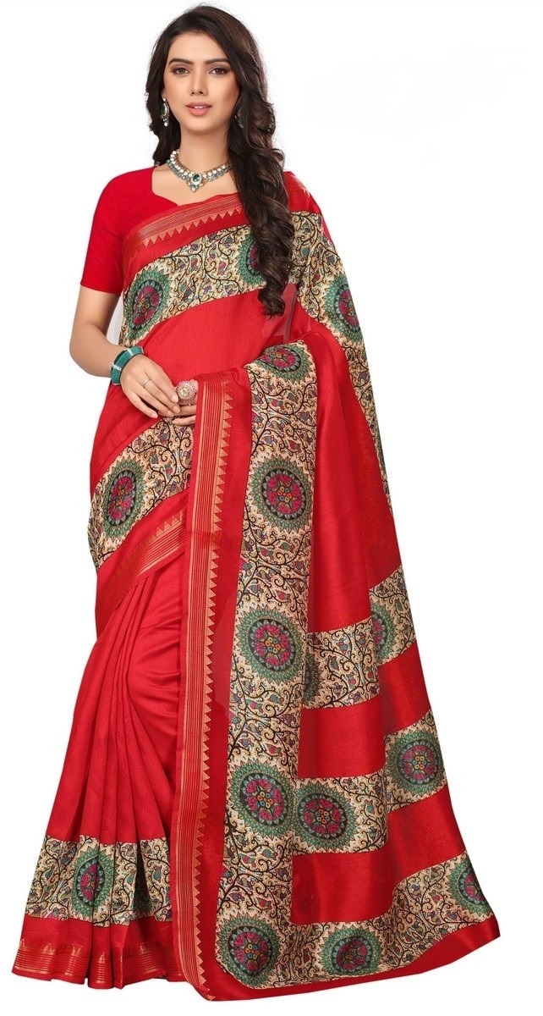
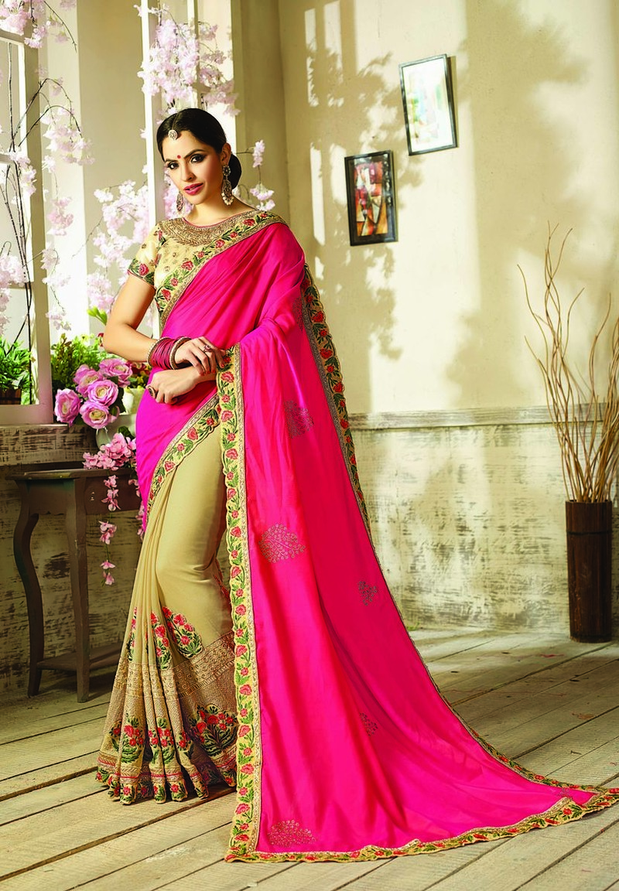
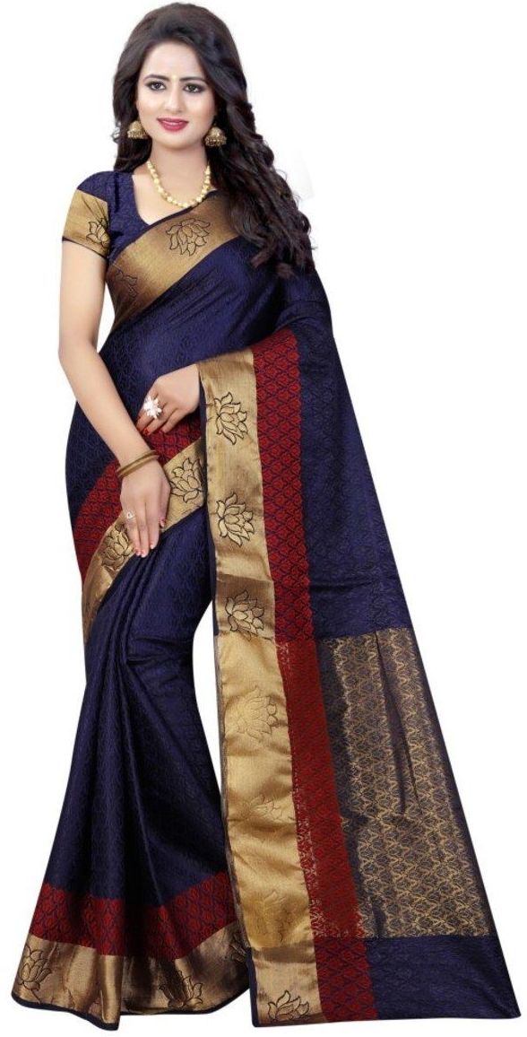
Tapadia Patta Silk Printed Saree
Silk Stone Work Saree
Silk Weaving Saree

Slide 21
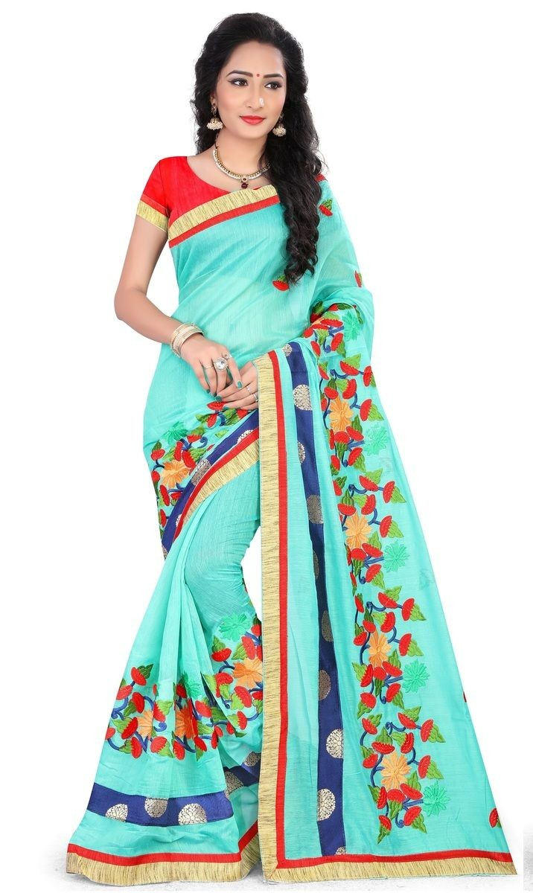
Chanderi Saree
Chanderi Saree has been proved that outfit that never gets too old to be shopped. Get some latest Wholesale Designer Pieces of Chanderi Sarees in Bulk.
Hurry up! Retailers, Get some Elegant Wholesale Chanderi Saree collection for your shop.
Some of the major Work types available for Chanderi Saree on our site are Embroidery, Border Work, Shaded.

Slide 22
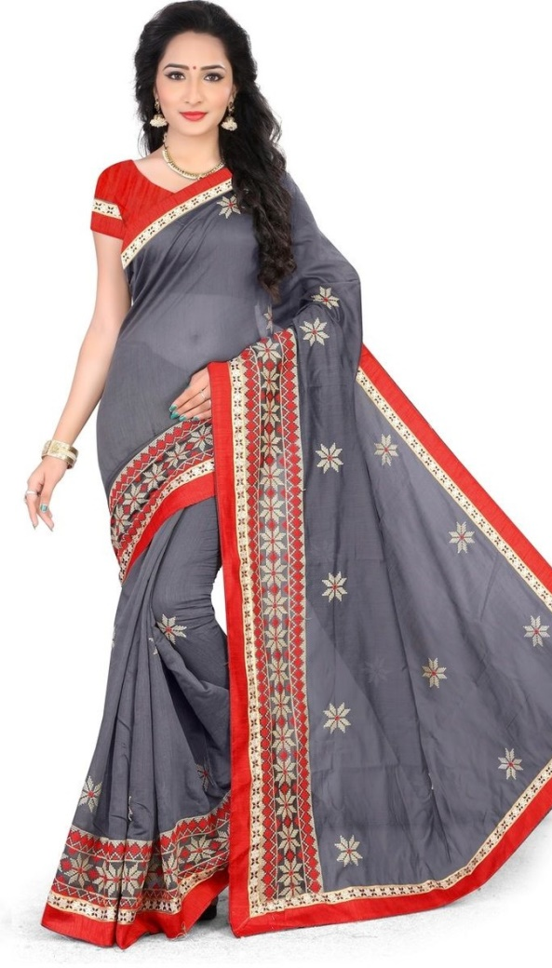
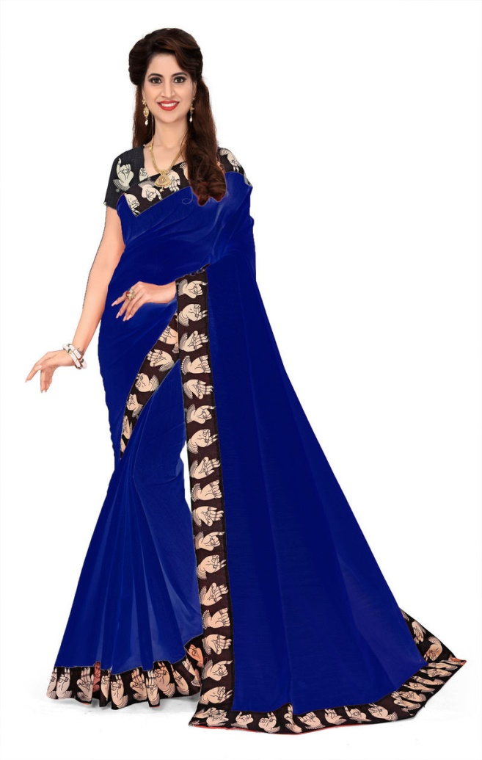
Work Types of Crepe Saree
Chanderi Embroidery Saree
Chanderi Borders Printed Saree
Chanderi Shaded Saree

Slide 23
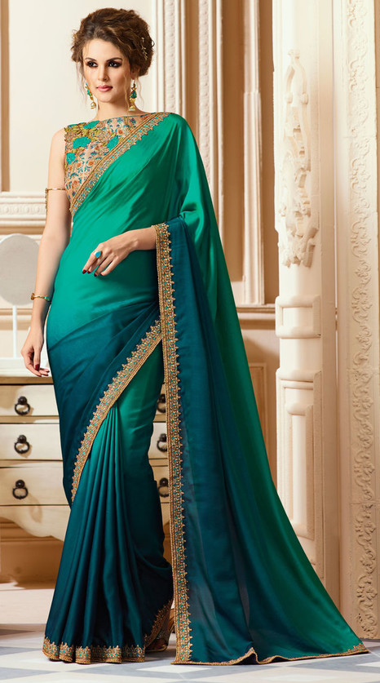
Crepe Saree
The main part of Crepe Sarees is that it comes in crisp and crinkled appearance. It is quite comfortable and sits lightly on the skin due to its heavy fabric. Does always in high demand.
Two of the best work type in Crepe Saree are Printed and Embroidery.
Have a look and get some of the Nice Bridal Crepe Saree collection on Lowest price in the market never before.

Slide 24
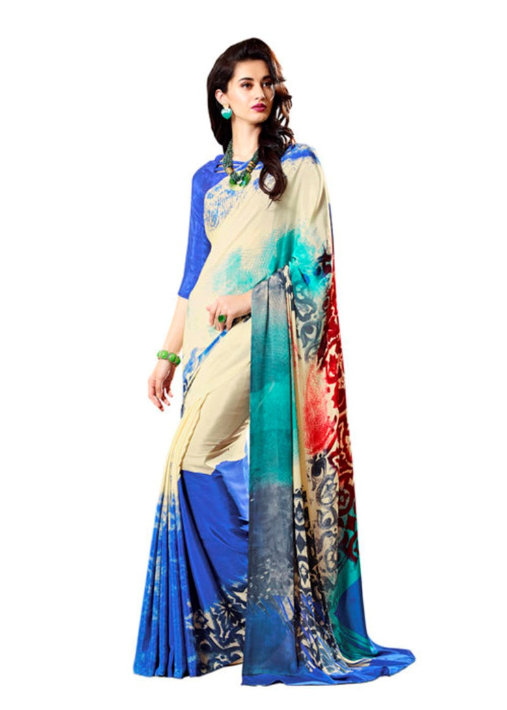
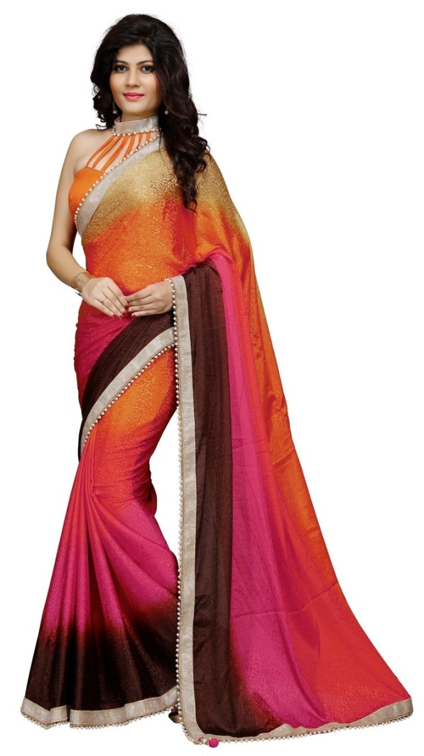
Work Types of Crepe Saree
Crepe Printed Saree
Crepe Embroidery Saree

Slide 25
CONTACT US..!
We are thinking Forward to Respond you.
www.wholesalebox.in
(+91)141-4049163
info@wholesalebox.in
(+91)-8696491521
support@wholesalebox.in

